Slide 1

JIBEBE MECHANICAL WEEK 12
Notes:
‹#›

Slide 2
TASKS DONE
Flywheel coupling hardening
Steering developments

Slide 3
MILD STEEL HARDENING PROCESS
Mild steel is packed in a steel box with graphite and the box is charged into a furnace at 900 degress . At this temperature the carbon infuses into the surface of the metal converting it to a high carbon steel, and the depth to which this takes place depends upon the time of treatment, but generally 3 or 4 hours are sufficient.

Slide 4
PROCESS CONT…
At the end of this time the box is allowed to cool slowly and when removed then steel parts consist of a soft mild steel core with a case of high carbon steel. Due to the prolonged heating at a high temperature the grain structure of the core will be relatively coarse, so that as well as hardening the case, a treatment will be necessary to refine and toughen the core. The core may first be refined by heating to about 900 degrees and quenching in oil after which the case is further hardened by heating to 770 degrees and quenched in water.

Slide 5
FLOW CHART OF MILD STEEL HARDENING PROCESS
Furnace|at 900 degrees
Graphite|
Cooling with the mild steel
Quenching in oil and water
A layer of high carbon steel
is formed on the surface of the
mild steel while the core remains to be of mild steel
The steel is allowed to cool
slowly, which forms the hard
High carbon surface
The mild steel is heated to 900 degrees in the presence of graphite
Quenching is done to toughen the core

Slide 6
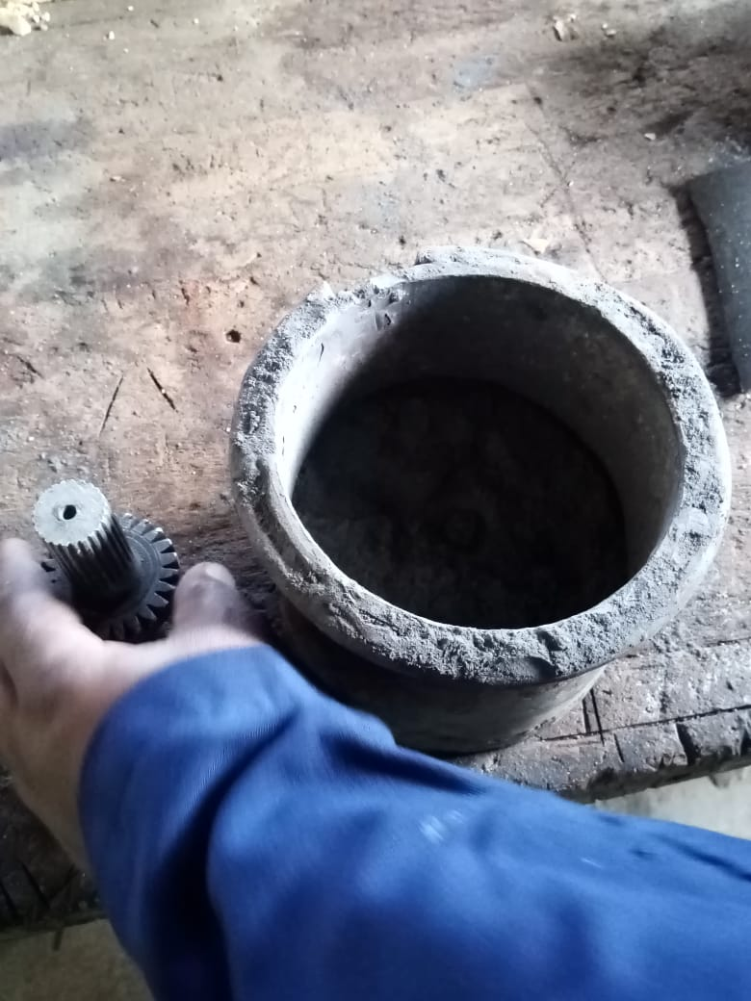
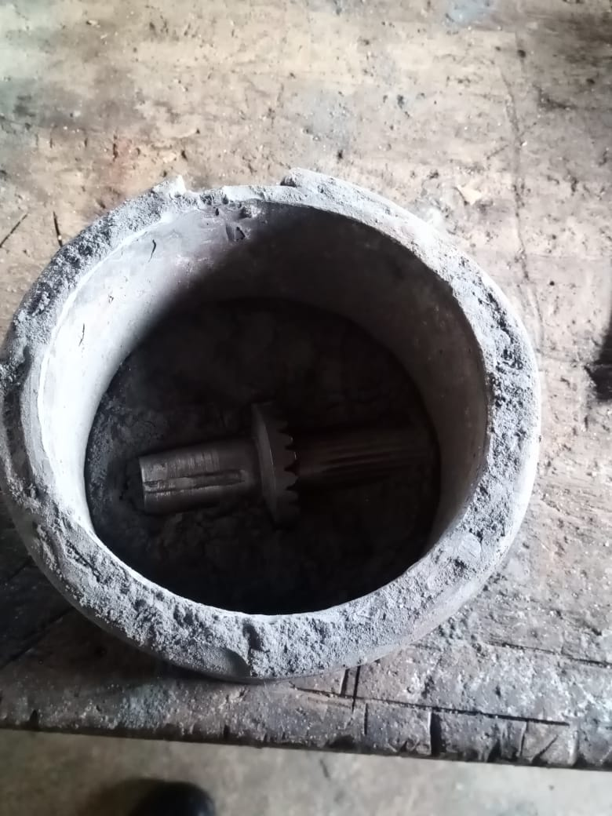
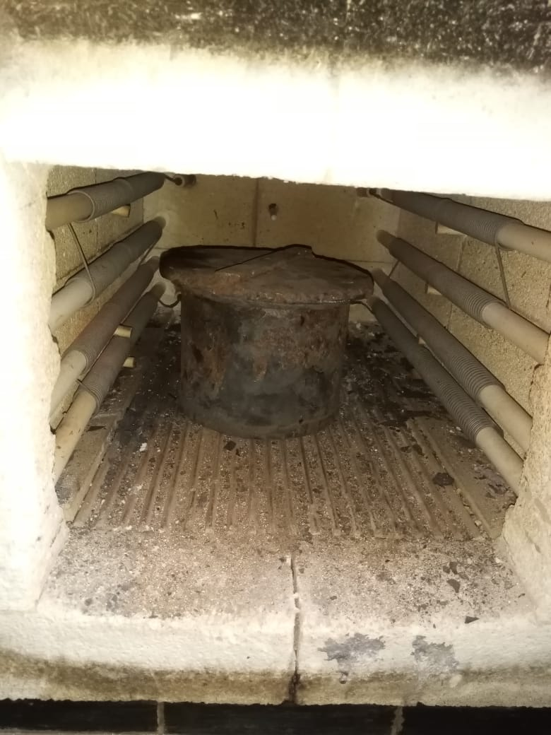
PROCESS IS STILL ONGOING AT THE FOUNDRY SHOP

Slide 7
STEERING DEVELOPMENT
This was done so as to fit the steering wheel to the column

Slide 8
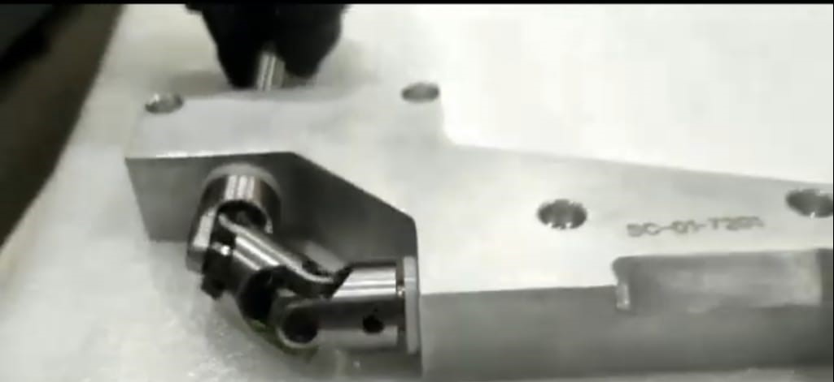
UNIVERSAL JOINT
U-joints are used to connect two shafts with misalignment. The choice of the ujoint is determined by the angle between the input and output shaft. Common ujoints have a maximum angle of 7 degrees.

Slide 9
In our case, we had to turn the motion through an angle of 90 degrees. For such cases, double universal joints connected at 90 degrees out of phase with each other are used to increase the angle that can be turned, and maintain a uniform angular velocity.
Video; https://youtu.be/Y43FCHbUwr

Slide 10
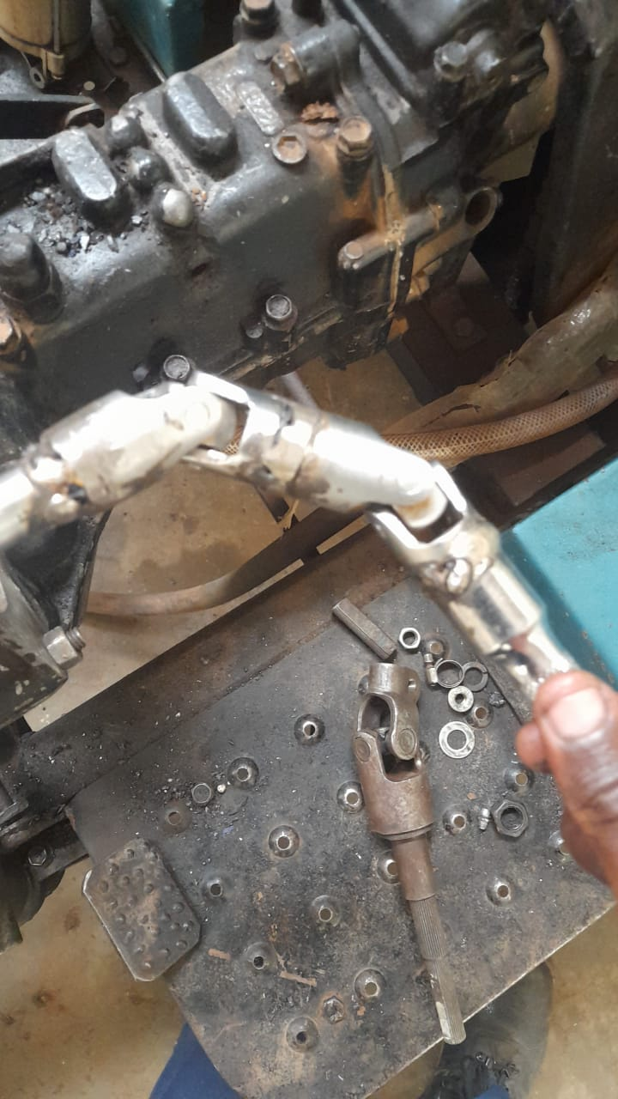
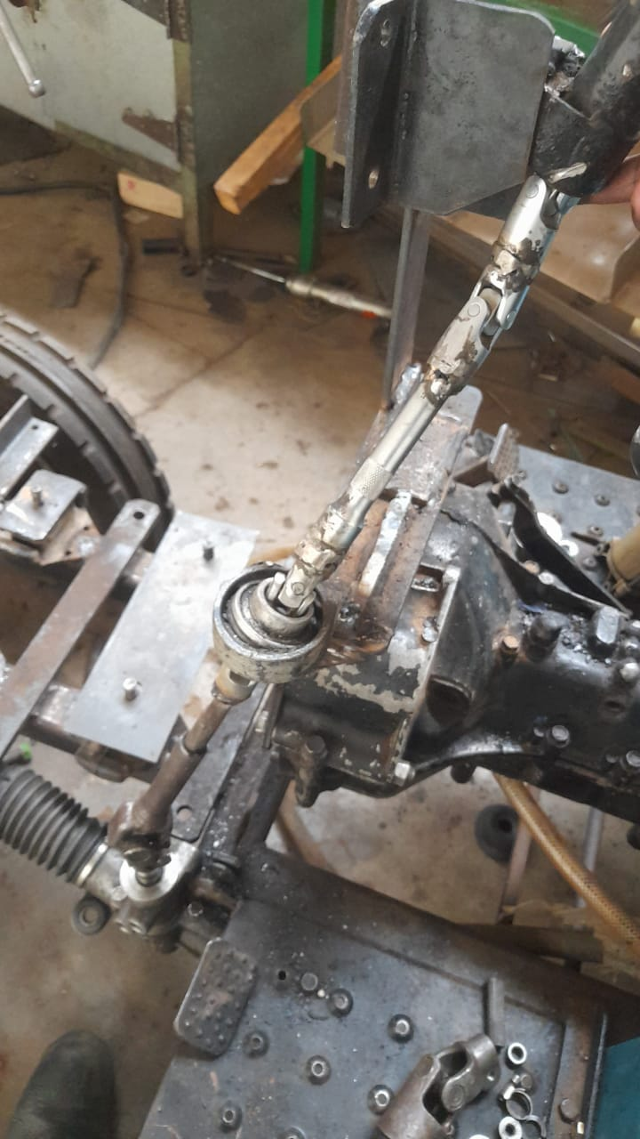
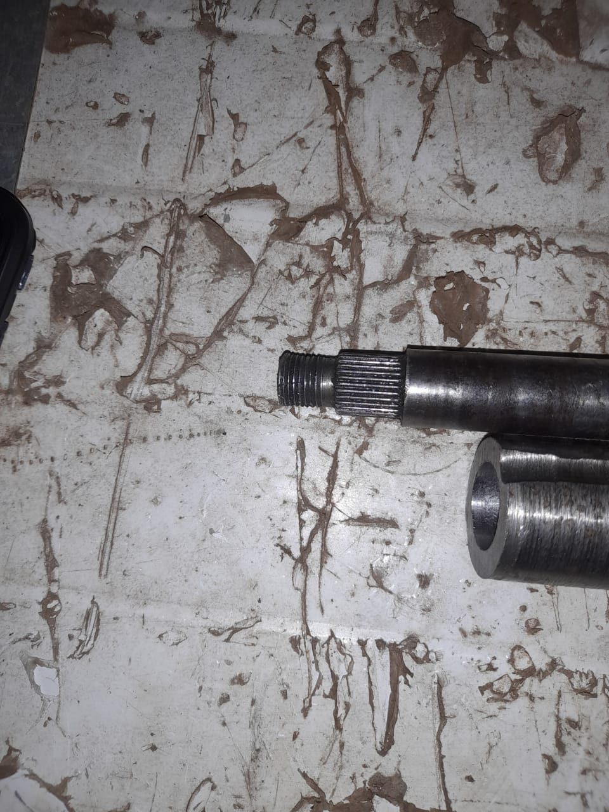

Slide 11
